Slide 1
Forecasting Forest Fires
Chris Schaffer
DePaul University
DSC 425 Project
11/19/19

Slide 2
External Link to Video
https://youtu.be/q3n7lOVD-80

Slide 3
Background
Records of Amazon forest fires between 1998 - 2018
Relevant to current events
Features include fire counts from 23 Brazilian states
20 years of monthly observations
Statistics published by Brazilian govt
http://dados.gov.br/dataset/sistema-nacional-de-informacoes-florestais-snif
Sourced from https://www.kaggle.com/gustavomodelli/forest-fires-in-brazil
Application: Forecasting fire-fighting resource needs

Slide 4
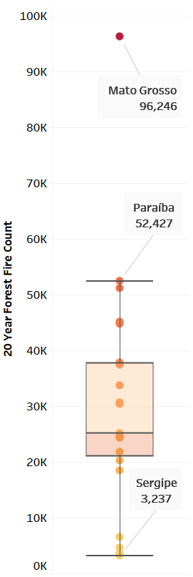
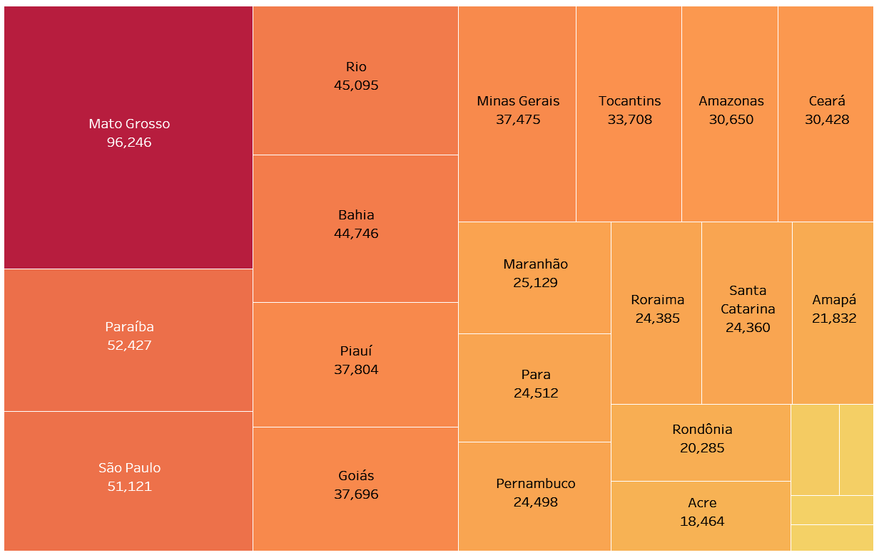
Exploration – Fires by State

Slide 5
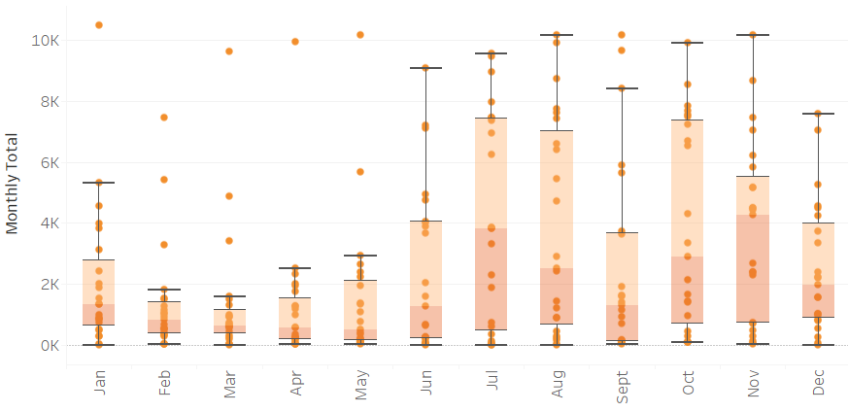
Exploration – Fires by Month

Slide 6
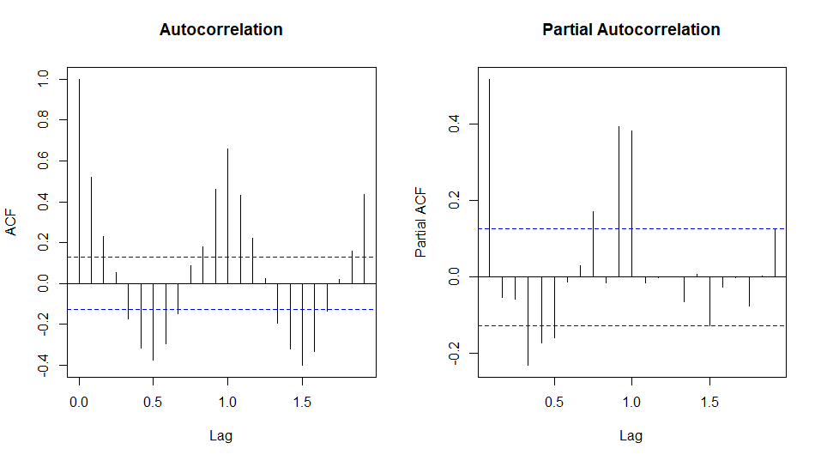
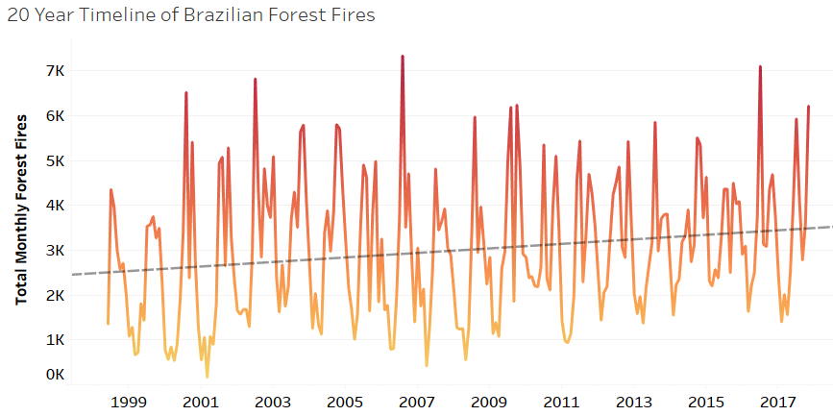
Exploration – Fire Time Series
Signal is not stationary…
Trend shows overall increase in fire counts

Slide 7
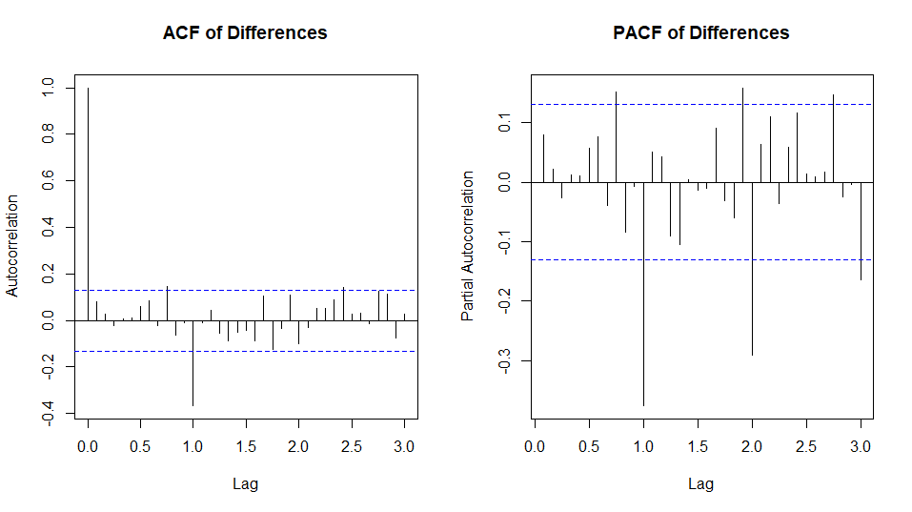
Differencing
Lag-12 differencing creates a stationary series
Corresponds to an annual seasonality
Ljung-Box p-value = 0.22
Relatively stationary
q = 12
p = 12

Slide 8
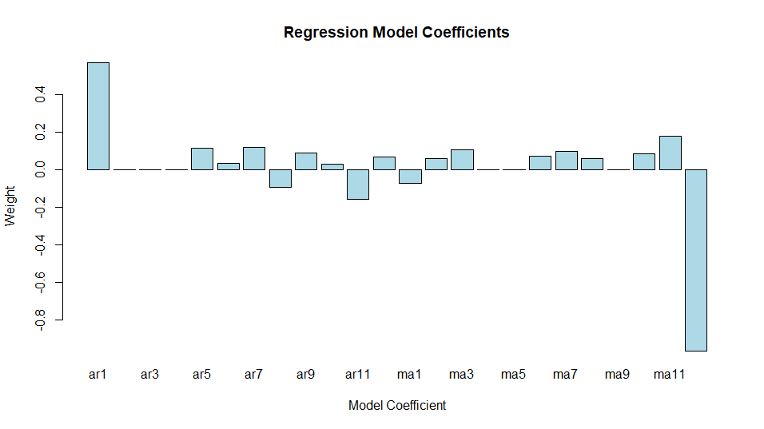
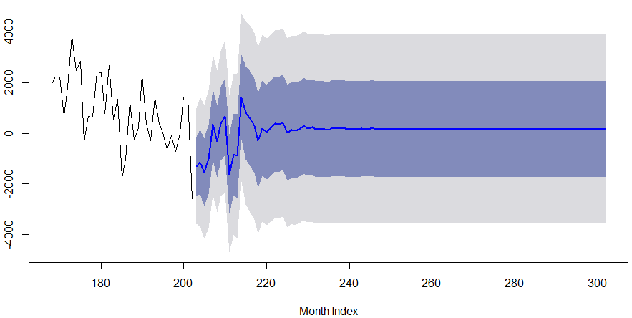
Modeling
Data was split 90/10 to allow for a 24 month comparison between predictions and actual data
ARIMA(12,0,12) was trained with pre-differenced series (d = 12)
PACF → p = 12
ACF → q = 12
Some insignificant coefficients set to 0
Regression equation is stationary and converges to a constant value (~163)

Slide 9
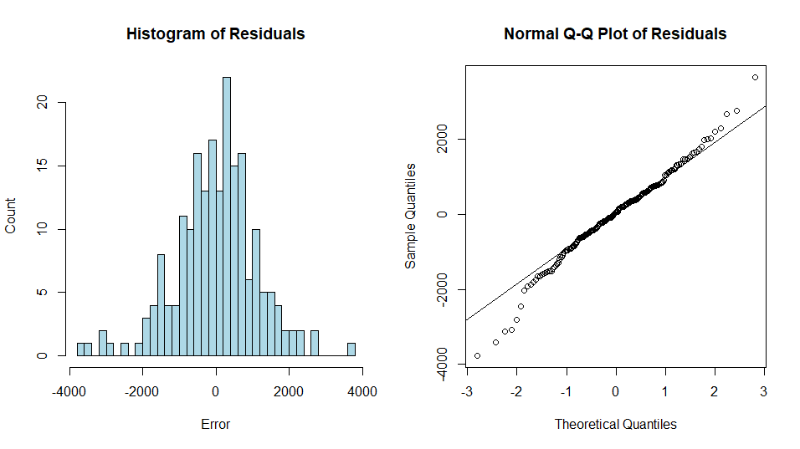
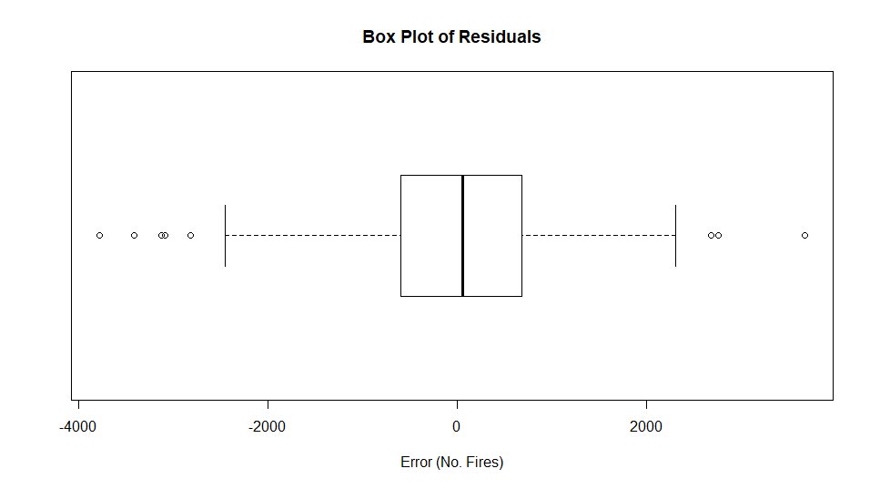
Residual Analysis
Distribution is not Normal (p = 0.001)
Lacks serial correlation (p = 0.71)

Slide 10
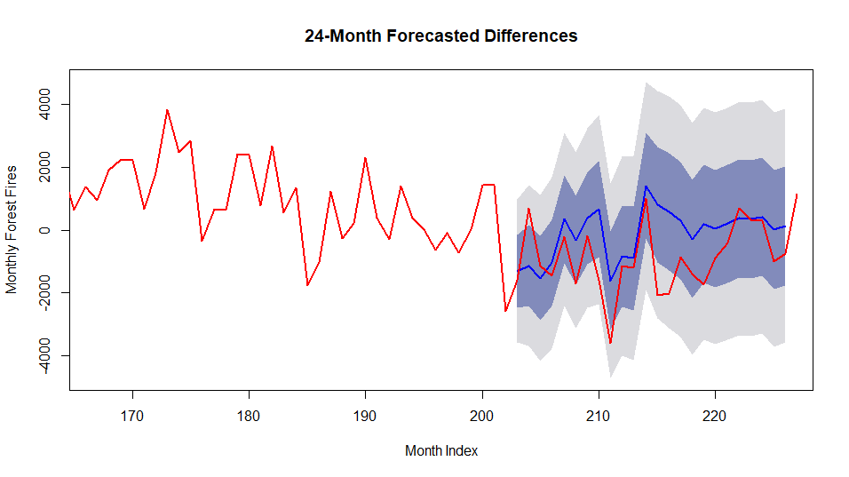
Forecasting
Plot (right) shows predicted and actual monthly differences
ARIMA(12,0,12) model generalizes well for a few months
Further predictions are dampened and less accurate
2σ
1σ

Slide 11
Conclusions
There has been a steady increase in Brazilian forest fires over the past two decades
Fires counts have a strong dependency on state and season
Custom ARIMA(12,0,12) model generalizes near-term changes well
Could help automate resource planning and work load forecasts

Slide 12
Future Work
Determine if state-based models are more accurate
Can a composite model be made from several?
Does simplifying ARIMA model improve forecasting?
Adjust window size for training data

Slide 13
Thanks!

